Slide 1
Massachusetts sports betting: history, legality and policy considerations
Paul Connelly, Director of Licensing, MGC
Justin Stempeck, Associate Counsel, MGC
Notes:
NOTE:
To change the image on this slide, select the picture and delete it. Then click the Pictures icon in the placeholder to insert your own image.

Slide 2
Why Sports Betting? Why Now?
The Professional and Amateur Sports Protection Act (“PASPA”)
Passed in 1993
Federal prohibition on sports betting except Nevada, also allowed for sports lotteries in Oregon, Delaware and Montana
PASPA says:
it shall be unlawful for a governmental entity to
Sponsor, Operate, Advertise, Promote, License or authorize by law or compact
A lottery, sweepstakes, or other betting, gambling or wagering scheme based directly or indirectly…on one or more competitive games in which amateur or professional athletes participate or on one or more performances of such athletes in such games.
What does this mean?

Slide 3
New Jersey’s PASPA Challenge – Why Everyone is Talking
First State to formally challenge PASPA
Started in 2011 – NJ voters approved referendum to allow for sports betting in state
Passed into law in 2012, state could issue licenses to casinos/racetracks to allow sports betting
NBA, NFL, MLB, NHL, NCAA immediately sued in Federal Court – Leagues win 2013
NJ appeals to 3rd Circuit Court of Appeals, 3 judge panel affirms lower court
The Court decision suggested NJ couldn’t affirmatively legalize sports betting so NJ decriminalizes sports betting at licensed racetracks and casinos
Leagues sue again. NJ loses again. NJ appeals again, 3rd Circuit panel affirms again.
NJ requests ‘en banc’ hearing – NJ loses 6-3. NJ appeals to the Supreme Court.

Slide 4
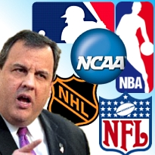
New Jersey Goes to Washington
Supreme Court only hears 1% of cases
Question at center of the discussion: Does PASPA ‘commandeer’ states and require them to maintain a prohibition on sports betting, violating the 10th Amendment?
Tenor of questions by the Justices was skeptical of PASPA
Decision finds in favor of New Jersey, PASPA is overruled
Sports betting is a state by state decision

Slide 5
What’s been happening in Massachusetts as NJ fought its way to the Supreme Court?
2011 Expanded Gaming Act, M.G.L. c. 23K passed
Plainridge Park Casino opened in June 2015 – slots only
MGM in Springfield slated to open August 2018 (full casino)
Encore Boston Harbor slated to open June 2019 (full casino)
Daily Fantasy Sports legalized via temporary law in August 2016 (expires July 2018)
Daily fantasy sports must comply with Attorney General consumer protection regulations
Daily fantasy sports are not gambling
State Legislature created a commission to study online gaming and daily fantasy sports
During that commission all three casino licensees indicated they favored sports betting at their facilities
Commission drafted a report distributed to legislature with various recommendations
MGC authored a white paper on Daily Fantasy Sports
MGC authored a white paper on Sports Betting

Slide 6
What’s been happening in Massachusetts as NJ fought its way to the Supreme Court – cont’d
Only two pieces of pending legislation that tangentially address sports betting
One bill was filed well before the Supreme Court decision the other more recently as an amendment to the budget
Both are more focused on setting up a framework to permanently legalize DFS and place it under regulation by the Massachusetts Gaming Commission
Would establish a tax
Registration fee
Consumer Protections
Both would establish a study committee to examine impact of sports betting legalization in the Commonwealth
Both bills currently in committee (Legislative Session ends 7/31/18)
DFS was previously legalized in Chapter 219 of the Acts of 2016 but only through 7/31/18, currently pending H.4297 would make that legalization permanent
That version has no registration fee, tax or oversight from any entity aside from existing attorney general consumer protection regulations

Slide 7
What has the discussion been in Massachusetts since the Supreme Court Decision?
Governor Charlie Baker initially said “it’s certainly something we should look into”
Now is saying we have a lot of “homework” to do on the topic
Democratic House Speaker Robert Deleo strongly implied it will not be reached this legislative term and will require additional research to craft legislation
Notably, both CT and RI have either proposed legislation that legalizes sports betting
MGC has taken no official position on the legalization of sports betting
Any legalization of sports betting would require decriminalization of many offenses codified in statute
Would need to determine what entity would regulate the industry and how it would regulate
Would need to determine if there would be a detailed, comprehensive law or a more general grant of authority to a regulatory body empowered to draft regulations as necessary

Slide 8
What’s the size of the illegal sports betting market nationally?
The $100 ($200?, $300?) Billion Question
Nationwide there are many estimates – inherent difficulty given that sports betting is illegal almost everywhere
AGA put out a figure of $150 billion, more conservative views present $50-60 billion
These projected figures represent “handle” or total amount wagered
Revenue from such handles is roughly 5%
A $50 million handle produces only $2.5 million in gross gaming revenue
Most state taxes apply to the revenue, not the handle

Slide 9
What’s the size of the sports betting market in Massachusetts?
Limited state specific studies
AGA commissioned study by Oxford Economics suggested a range of possible tax revenues in Massachusetts from a low of $8.6 million to a high of $61.3 million
These figures assume a handle in Massachusetts of between $127 million and $472 million
AGA study looked at different tax rates and different distribution models all of which are critical in evaluating the market
Not a small market, but not the solution to every state budget shortfall either
Sportsbooks are a low margin business

Slide 10
What does illegal sports betting look like? How is it evolving?
Sophisticated and technology driven
Mobile and app platforms are critical
Growth of in-play betting
Multiple online sites easily available
Local bookie is likely using a ‘pay per head’ software as a service to run his operation
With the growth of cryptocurrency there has been a parallel growth in online casinos and sportsbooks that accept cryptocurrency with obvious concerns regarding consumer protection, money laundering and criminal connections

Slide 11
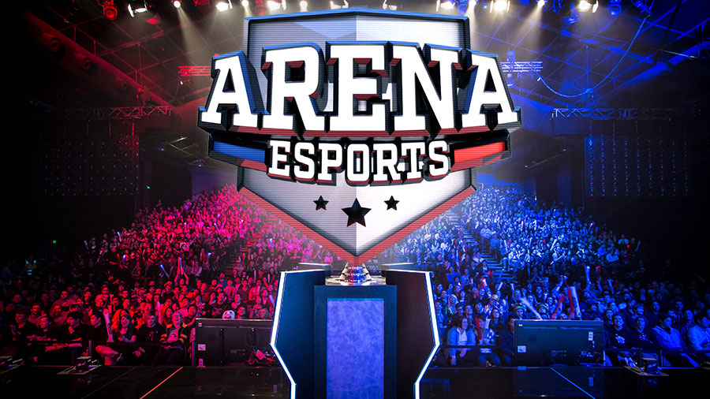
Unsettled questions in sports betting legalization
What sports can you bet on? Minor League? College? Esports?
How do you define ‘sports?’
What are other states doing?
What has Nevada done?
Balancing regulatory efforts and
black market concerns

Slide 12
Legalization?: Framework for Approach
Potential legalization efforts guided by overarching policy objectives, including but not limited to a desire to:
Transition sports betting activity from black market to legal, regulated markets
Capture tax revenues
Expand economic opportunities to potential providers and related industries
Identify and mitigate potential negative externalities, including efforts to promote responsible gaming

Slide 13
Minimizing the Black Market
Essential considerations when attempting to attract bettors away from black market:
Online / Mobile Availability
Convenience and accessibility matters; competition with increasing sophistication of black market
Products Offered
Illegal products offer full range of sports betting options (e.g. in-game betting); increasingly attractive to betting public
Taxes and Fees
Sportsbooks are relatively low-margin operations; taxes and fees impact profitability and ability to offer attractive odds and products vs. black market
Security / Consumer Protection
True differentiator from black market – finally bettors can engage in safe market
Responsible Gaming
Legal providers could provide tools to allow bettors to monitor and manage betting activity

Slide 14
Implementation Considerations
Who (i.e. which providers) should be allowed to participate in offering sports betting?
Where (i.e. through which access channels) should sports betting be allowed; brick & mortar, online, or both?
What types of bets and on which types of contests should sports betting be allowed?
When and at what pace should sports betting be allowed; gradual rollout or all-at-once?
How should sports betting be taxed and regulated?

Slide 15
WHO should be allowed to provide sports betting?
Potential first-mover advantages make this an important question
Is sports betting an extension of an existing regulated market, or a new activity?
Likely stakeholders:
Existing Gaming Licensees
Racetracks / OTB
Native American Tribes
Lottery
New Brick & Mortar Entrants
New Online Entrants

Slide 16
WHERE should sports betting be allowed?
Basic Model:
Brick & Mortar
Bets and payouts conducted in-person at authorized provider
Online
Bets and payouts conducted over the internet using computers, tablets or smartphones
Brick & Mortar betting is seen primarily as a driver of non-gaming (e.g. food, beverage, room) revenues at casinos
Online sports betting – based on convenience and ability to rapidly evolve to meet consumer demand – is increasingly popular; may be critical factor in transitioning bettors from black market to legal market

Slide 17
WHAT types of bets should be allowed?
What is the appropriate range of betting options?
Traditional Sports
Horse Racing
Professional Sports (e.g. Football, Baseball, Basketball, Hockey)
Amateur Sports (e.g. Football, Baseball, Basketball, Hockey)
New “Sports”
eSports
Virtual Sports
“Futures” Betting
Entertainment (e.g. Reality TV Shows)
Elections
Other Real-World Events
In-Game Betting?

Slide 18
WHEN and at what pace should sports betting be allowed?
First-mover advantages among states
Northeast identified as potentially most active region to adopt sports betting
Immediate roll-out, or wait and see

Slide 19
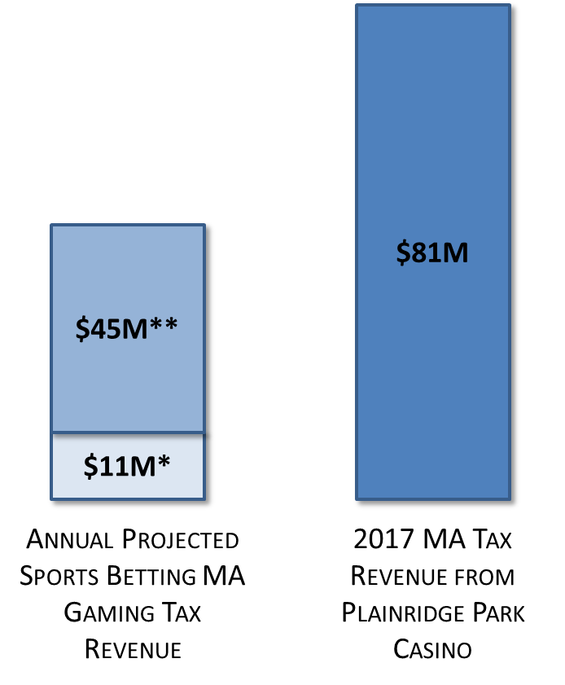
HOW should sports betting be taxed and regulated?
Goal is to create legal marketplace that is safe for bettors and provide Commonwealth opportunity to capture revenues
Tax rates are traditionally high on high-margin casino gaming
Tax rates and fees (including “integrity fees” ) must be
considered within context of sports betting profitability and
public policy desire to transition betting activity from black
market
Regulatory approach can be accomplished through:
Strong statute addressing who, where, what, when and how
Empowered regulator to address who, where, what, when and how
Online considerations may make an “Omnibus Regulatory Approach” attractive

Slide 20
QUESTIONS?

