Slide 1
Clean Energy Presentation to the
Massachusetts Gaming Commission
DOER Commissioner Mark Sylvia
January 24, 2013

Slide 2
Dept. of Energy Resources Mission
Creating a Cleaner Energy Future for the Commonwealth
  Ensure deployment of all cost-effective energy efficiency
  Maximize development of clean energy resources
  Create and implement energy strategies to assure reliable supplies and improve the cost of clean energy relative to fossil-fuel based generation
  Support Massachusetts’ clean energy companies and spur Massachusetts’ clean energy employment

Slide 3
DOER Structure
DOER
Energy Efficiency Division
Energy Markets Division
Green Communities Division
Renewable/ Alternative Energy Division

Slide 4
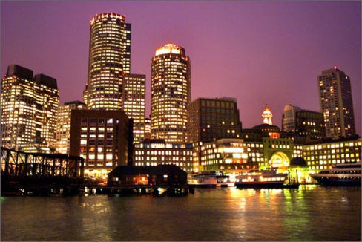
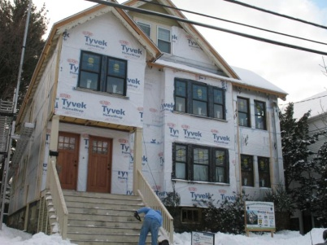

State Laws Drive Investments,
Create Economic & Environmental Opportunity, National Leadership
Green Communities Act (GCA)
  Green Communities
  All cost effective energy efficiency
  Advanced building energy codes
Global Warming Solutions Act (GWSA)
  Clean Energy and Climate Plan set GHG emission reduction goals at 25% below 1990 Baseline Levels by 2020; 80% reduction by 2050
Governor Patrick’s Renewable Energy Goals
  Install 250 megawatts of solar capacity by 2017
  Install 2000 megawatts of wind capacity by 2020

Slide 5
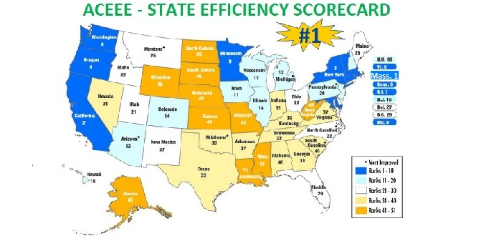
Massachusetts‘ Clean Energy Success Story
Ambitious energy and environmental goals, combined with strong support of clean energy economy
  #1 state for energy efficiency (ACEEE)
  #3 in private clean energy investment
  2012 Massachusetts Clean Energy Industry Report
  Nearly 5000 clean energy firms
  More than 71,000 workers
  1.7% of total Mass. Workers
  11.2% employment growth
110 Green Communities
122 Stretch Code Communities
174 MW of solar PV installed
61 MW of wind generation installed
Electric vehicle charging stations: over 250 charge points; 124 public EV stations
Nearly $70 million in clean energy ARRA funding

Slide 6
Integrating Clean Energy into Your Development

Slide 7
The Gaming Bill, Section 18:8
Utilizing sustainable development principles including, but not limited to:
  Energy Efficiency
    Stretch code
    ENERGY STAR® electrical and HVAC equipment and appliances
    Monitoring and metering energy consumption
    LEED certification
  Renewable/Alternative Energy
    Alternative transportation strategies
    Water conservation and storm water management
    Renewable on-site generation or procurement
Notes:
Chapter 194
The 2011 Expanded Gaming Act (ch. 194 of the Acts of 2011) grants the Gaming Commission the full discretion to issue a gaming license. In making such a determination, the Commission may look for the advancement of certain objectives in the license application, including those regarding sustainable development principles. A license is not required to contain these principles, however, they are stated objectives of the Commonwealth and likely serve to help the project as the Commission evaluates the application of 2011, section 18 (8)

Slide 8
Green Communities
Notes:
You may be proposing a facility in a Green Community. Here are some things to know about those communities

Slide 9
Green Communities Grant Program
Qualification Criteria
Adopt as-of-right siting for RE/AE generation, R&D, or manufacturing
Adopt expedited permitting process
Create an Energy Reduction Plan to reduce energy use by 20% in 5 years
Purchase only fuel-efficient vehicles
Adopt Stretch Code or minimize life cycle cost
Green Communities Act, M.G.L. Ch. 25A §10
Notes:
Must meet 5 criteria, today only going to speak about #3

Slide 10
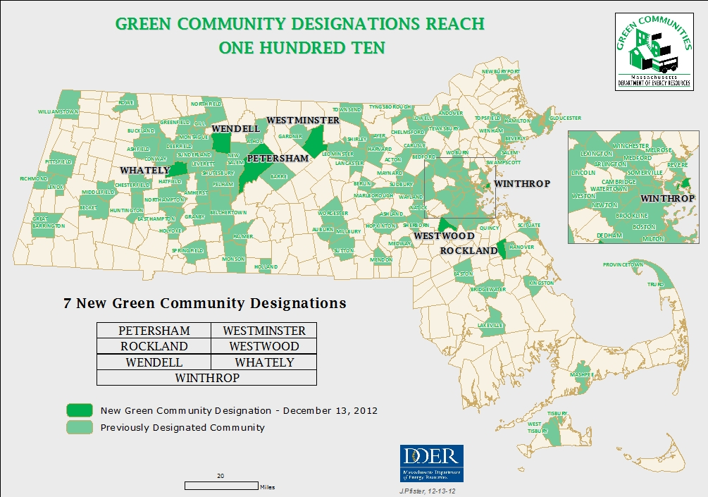
Green Communities Designation
  110 cities and towns designated Green Communities
  More than $24 million invested to implement energy efficiency and renewable technologies
  Total reduction of 1,809,059 MMBTUs committed, equivalent to the annual energy consumption of approximately 13,600 Massachusetts households

Slide 11
Energy Efficiency

Slide 12
Energy Efficiency as our First Fuel
Using less energy is our least expensive option to meet our energy needs
Energy efficiency programs are offered by Mass Save® utility and energy efficiency program sponsors to residential, low income, commercial & industrial customers
Leading By Example and Green Communities programs stimulate investments in public buildings
  Accelerated Energy Program will invest in energy improvements in 700 state sites, saving $43M annually

Slide 13
Nation-Leading Energy Efficiency Goals
2010-2012 savings equal to electricity for 363,000 homes annually and heat for 57,000 annually
2013-2015 savings equal to electricity for 514,000 homes annually and heat for 70,000 annually
Commonwealth remains on the path toward meeting the goals of the Clean Energy and Climate Plan
THREE-YEAR PLAN GOALS | 2010-2012 | 2013-2015 | % Change
Total Program Investment (million $s) | $1,627 | $2,020 | 24%
Total Benefits (million $s) | $6,039 | $8,980 | 49%
Annual Electric Savings (GWh) | 2,625 | 3,705 | 41%
Annual Gas Savings (million therms) | 57 | 72 | 26%
Notes:
Talk about sectors served: low income, residential, commercial & industrial
Process:
EEAC
DPU

Slide 14
Massachusetts 2013-2015 Energy Efficiency Plans Comparing Benefits: Statewide vs. C&I
Benefits per Program Dollar Spent

Slide 15








Energy Efficiency in Buildings
Mass Save® provides comprehensive, integrated gas and electric strategies and delivery
  Serves the commercial, industrial, and municipal sectors
    Existing buildings – retrofit opportunities
    New buildings and major renovations
    Direct install – turnkey delivery
  www.masssave.com/business
15
Notes:
Federal Incentives
Tax and other incentives/standards
http://www.energystar.gov
http://www.dsireusa.org/incentives

Slide 16
Commercial & Industrial Programs
Design for Energy Efficiency
  Early design collaboration with Mass Save streamlines project planning and ensures a comprehensive approach to maximize opportunities
  Incentives up to 50% for cost of engineering study to identify high efficiency opportunities
New Construction
  Comprehensiveness and optimized systems through technical assistance
  Incentives up to 75% of incremental costs related to existing code
  NOTE: Working with Mass Save early in the process is critical
Retrofit
  Targets energy efficient opportunities for existing buildings and equipment
  Replaces inefficient equipment or systems
  Reduces owners’ operating costs
  Incentives up to 50%
Notes:
Primary Offerings
Technical Services
Generous Incentives
Opportunities to Consider
Interior and exterior lighting & controls (high efficiency linear fluorescent, LED fixtures)
High efficiency heating and cooling equipment & controls
Ventilation (DCV)
Energy recovery ventilators
Hot water (pool heating, laundry, kitchen and hotel use, etc.)
Kitchen equipment (hood controls, restaurant equipment, etc.)
Possibly CHP, solar thermal water heating

Slide 17

Massachusetts Building Energy Codes
Building energy codes are intrinsic market drivers for energy efficiency
What is the Massachusetts base code?
  IECC 2009/ASHRAE 90.1-2007, with Massachusetts amendments
  Updated every three years
  State expected to adopt IECC 2012/ASHRAE 90.1-2010 this year

Slide 18
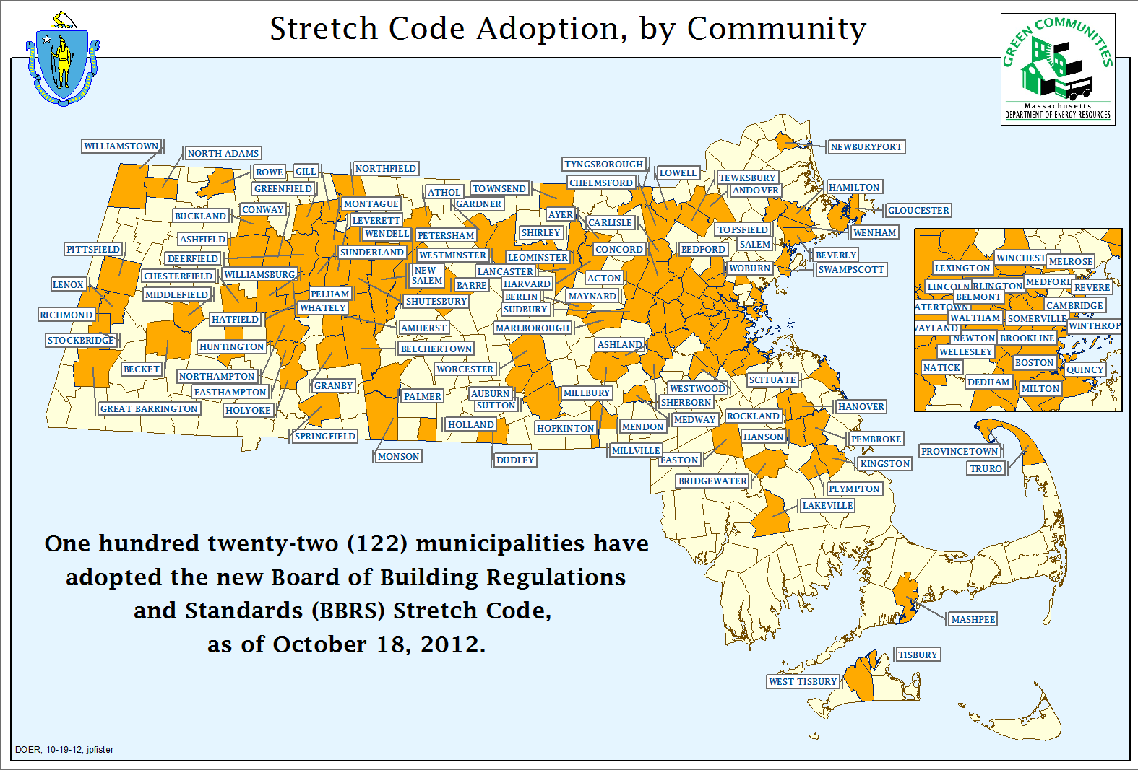
Notes:
18

Slide 19

What is the Stretch Code?
Amendment to the Massachusetts base energy code
15-20% more energy efficient
2012 IECC is based on Massachusetts 2009 commercial stretch code
Buildings over 100,000 square feet have to show 20% savings over ASHRAE 90.1 baseline code
2009 stretch code may be updated in 2013/2014
Notes:
For buildings under 100,000 sq ft, the 2009 stretch code and the 2012 IECC are identical.
For buildings above 100,000 sq ft, the 2009 stretch code requires ASHRAE 90.1 Appendix G modeling – the same modeling used for LEED New Construction

Slide 20
LEED and the Stretch Code
LEED for New Construction requires energy modeling using ASHRAE 90.1 Appendix G
Massachusetts stretch code and MEPA use the same Appendix G modeling
LEED requires at least 10% less energy than ASHRAE 90.1 baseline (more savings = more points)
Stretch code requires 20% less energy than ASHRAE 90.1 baseline (5 LEED energy points)
Notes:
For buildings above 100,000 sq ft, the 2009 stretch code requires ASHRAE 90.1 Appendix G modeling – the same modeling used for LEED New Construction
Only one set of modeling work is needed for LEED, MEPA and the stretch code; it’s already streamlined!

Slide 21
MEPA Review Process
DOER staff reviews and comments on stationary sources in all submissions subject to MEPA greenhouse gas (GHG) policy and protocol
  GHG policy and protocol establishes procedures & protocols for quantification of projected emissions for baseline and as-proposed (mitigated) cases
  Buildings protocol
    Requires energy modeling for both cases (baseline and as-proposed)
    Requires description of all mitigations for the reduction of energy usage and related GHG emissions
    Stretch code communities require modeling for buildings over 100,000 sq. ft. per ASHRAE 90.1-2007, Appendix G
Notes:
It might be helpful to reference CERP, noting the collaboration streamlines permitting among other values.

Slide 22
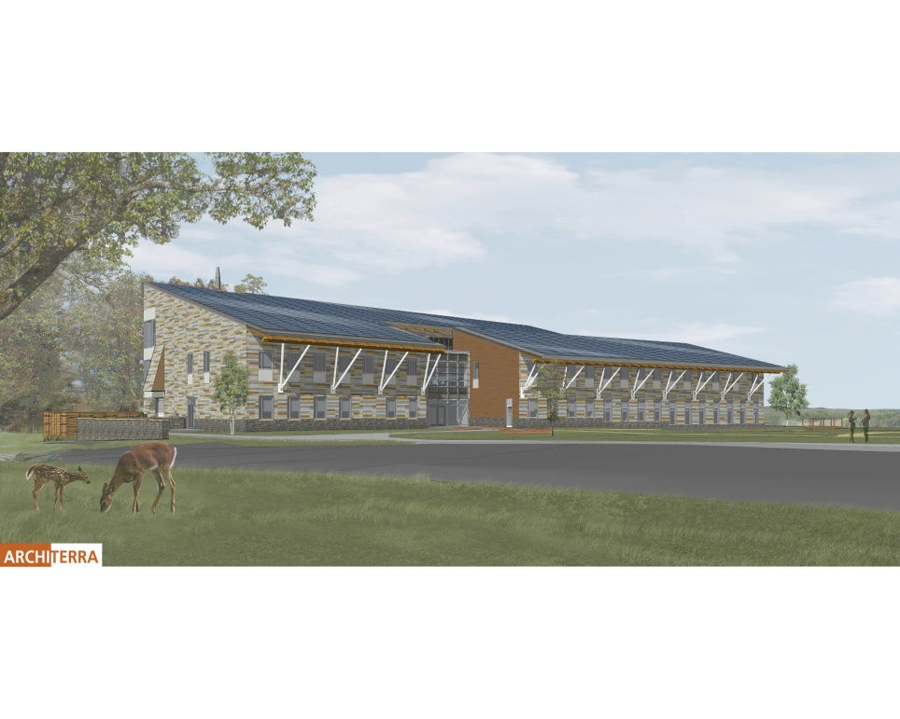
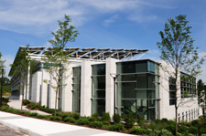
High Performance Buildings
State zero net energy buildings lead by example
  North Shore Community College
    natural ventilation, lighting, a green roof, building orientation, chilled beams, geothermal energy technologies and photo-voltaic panels
  Fish & Wildlife
Notes:
This is the kind of leadership building that we’d like to see

Slide 23
Renewable Energy

Slide 24
Programs for power generation
Renewable Energy Portfolio Standard – RPS Class I
  New (post-1997) renewable energy generation
  RPS Solar Carve Out – to grow solar PV sector to 400 MW
Alternative Energy Portfolio Standard
  Combined heat and power (CHP) of key importance – provides credits for efficiency gains in combined electric and heat generation
Net metering
  Allows on site power generation to run electricity meter to run backwards – providing an additional incentive
Study/Investment support
  MassCEC and/or DOER administered
24
Notes:
RPS Class I – Solar Carve-Out
MA is now amongst the top 3-5 solar markets in U.S.
Installed capacity over 176 MW, install rate about 10 MW/month
2012 SREC market transitioning from undersupply to oversupply. SREC prices have fallen, even below Auction Price of $285/MWh.
DOER has announced intent for rulemaking to adjust compliance obligation formula, and set forward ACP Rate Schedule.
RPS Class II – Existing Renewables (pre-1998)
Supply of Class II RECs are far short of Minimum Standard, resulting in substantial reliance on ACP compliance.
Legislature has directed DOER to make recommendation to reduce ACP reliance.
Alternative Energy Portfolio Standard (APS)
Program has spurred development of CHP in MA. Currently qualified about 50 MW of CHP.
Supply of AECs remains short of Minimum Standard.

Slide 25
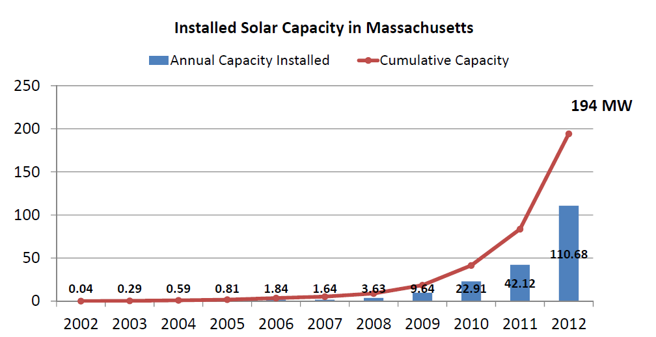
Status of Solar in Massachusetts
Solar installed: 194 MW installed
  65-fold growth since 2007, PV in 341 of 351 communities
  Electricity produced = 30,684 homes annually
  GHG reductions = 20,858 cars annually

Slide 26
Renewable Thermal Programs
Residential and commercial biomass heating pilot program - $2 million
Residential and commercial air source and ground source heat pump pilot programs - $2 million
Community district energy financing - $2 million
Renewable heating in public housing – DHCD partnership - $2 million
Renewable thermal business investment financing program - $3 million
Wastewater heat recovery - $1 million
Ongoing: MassCEC Commonwealth Solar Hot Water program - $10 million (until 2016)

Slide 27
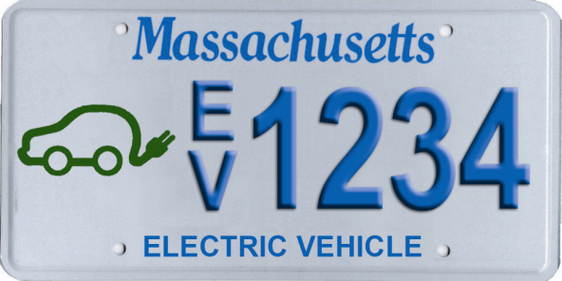
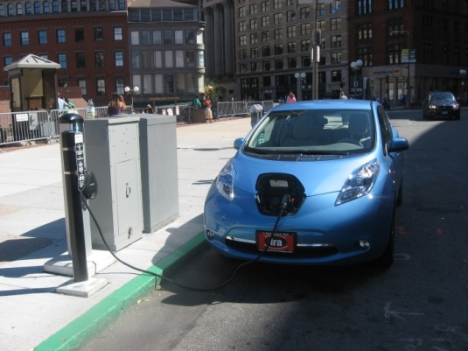
Transportation Initiatives
GreenDOT
Green Community Incentive
  Criterion 4: Purchase fuel-efficient vehicles
Partnerships
  Utilities - infrastructure
  MOUs with manufacturers - infrastructure development
  Registry of Motor Vehicles – EV/hybrid license plate
EV pilot required from NU/NSTAR merger
Education & training on EVs
  State licensing board, Electricians, First responders
Notes:
Links to public transportation
Rideshare
Shared ride
Smart growth
Bicycles

Slide 28
How Can DOER Help?
Mark Sylvia
Commissioner, DOER
Mark.Sylvia@state.ma.us
www.mass.gov/doer

