Slide 1
Massachusetts Clean Energy Center
Massachusetts Gaming Commission
January 24, 2012

Slide 2
About the Massachusetts Clean Energy Center
Established under the Green Jobs Act of 2008
Dedicated to accelerating the success of clean energy technologies, companies and projects in Massachusetts
Focused on creating high-quality jobs and long-term economic growth for the people of Massachusetts
Supports growth of early-stage companies
Supports municipal clean energy projects
Invests in residential and commercial renewable energy installations

Slide 3
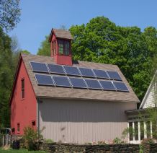
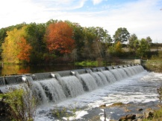
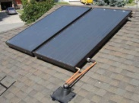
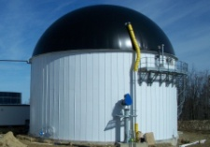
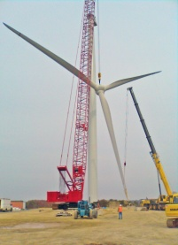
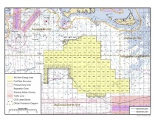
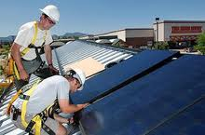
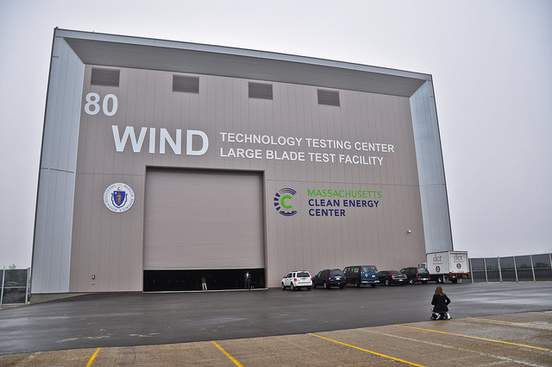
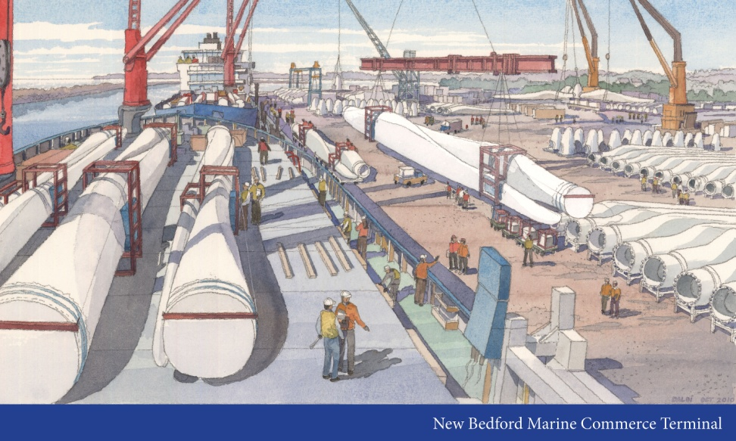
Programs

Slide 4
Benefits of High Performance Buildings
Cost Savings
Reduced Environmental Impacts
Safer, Healthier Workplace
Increased Employee Productivity
Higher Customer Satisfaction
Positive Public Relations
Green Marketing Opportunities
Awards and Recognition

Slide 5
Operating costs decrease 13.6% for new construction and 8.5% for existing building projects
Building value increases 10.9% new construction and 6.8% existing building projects
Return on investment improves 9.9% new construction and 19.2% existing building projects
Occupancy increases 6.4% new construction and 2.5% existing building projects
Rent increases 6.1% new construction and 1% existing building projects
McGraw Hill Construction. Green Outlook 2011: Green Trends Driving Growth

Slide 6
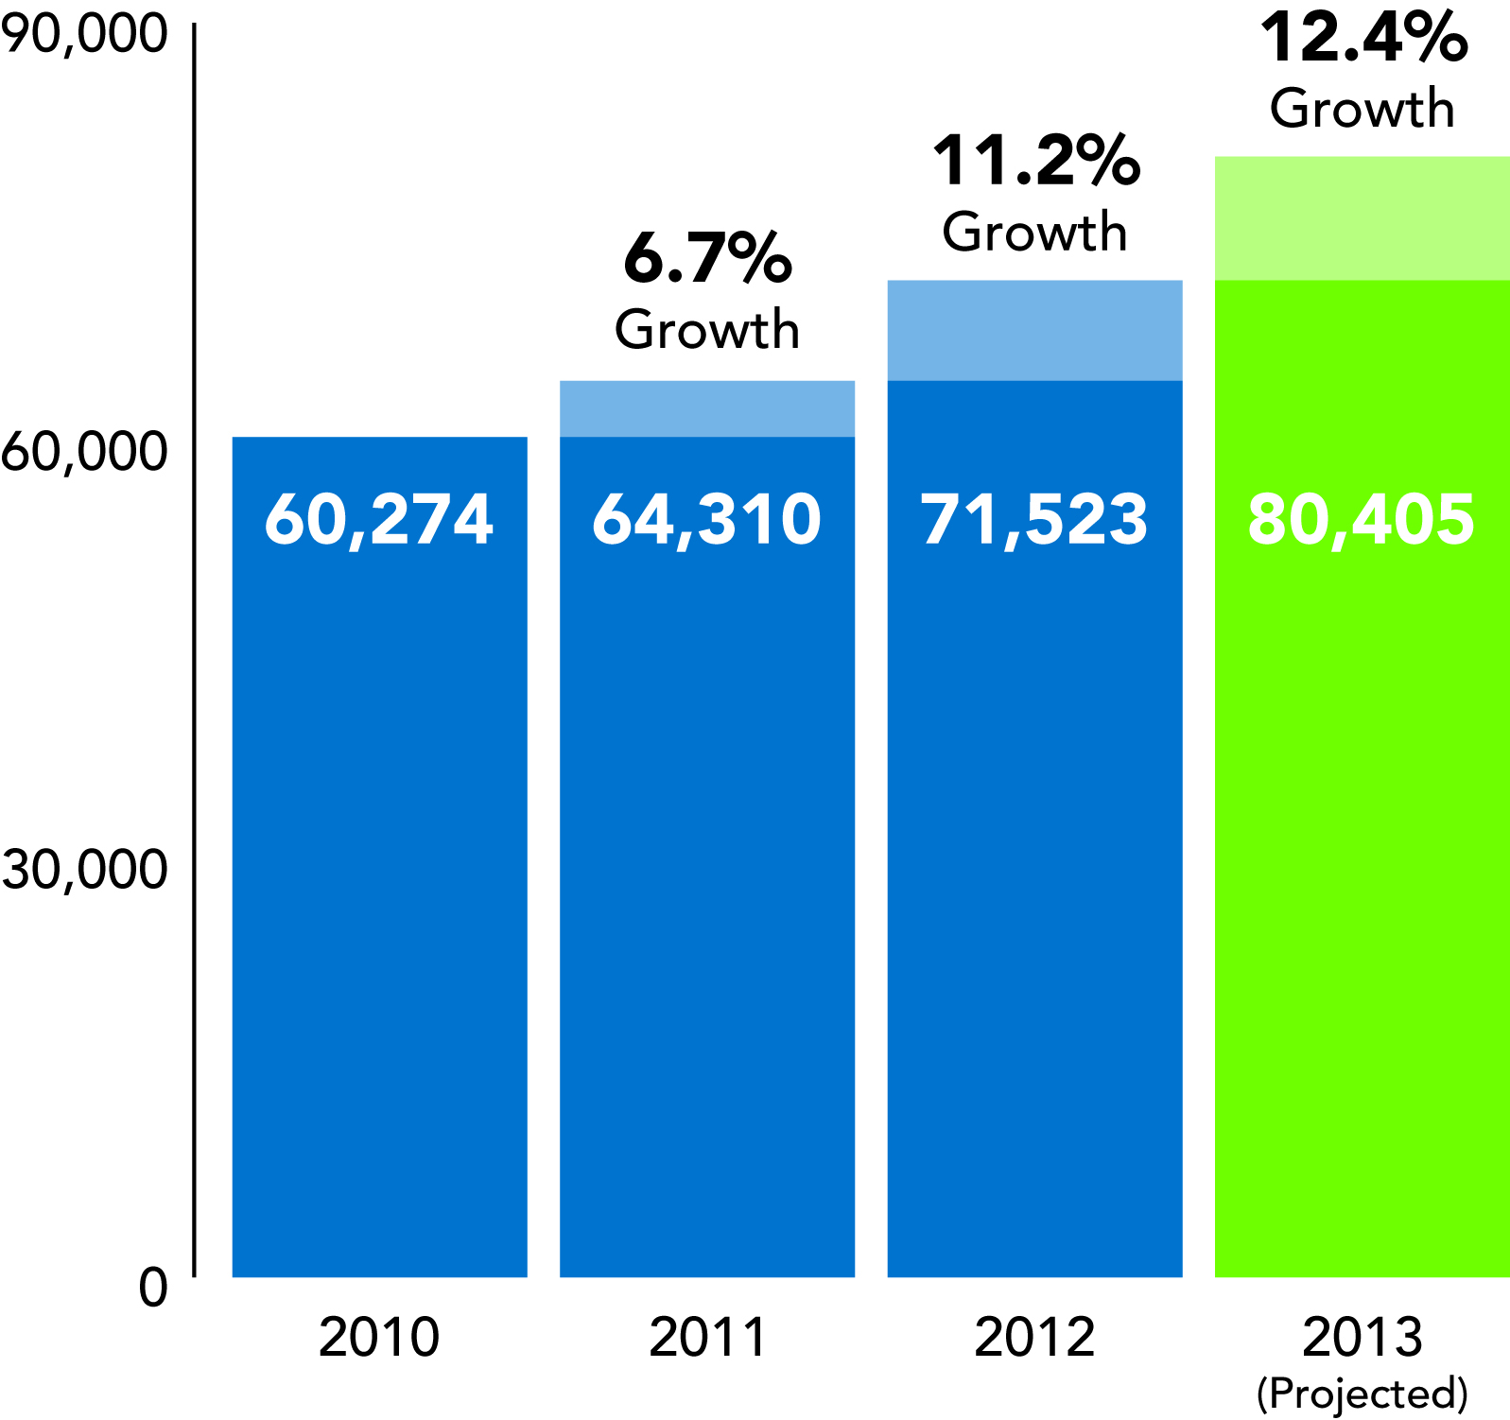
Massachusetts’ Clean Energy Economy is Large and Growing
11.2% growth since 2011
4,995 clean energy firms
71,523 clean energy workers
1.7% of all workers in Massachusetts

Slide 7
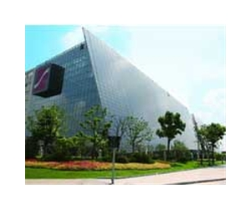
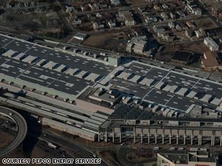
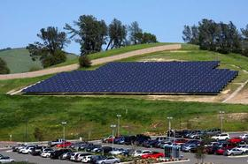
Harrah’s Rincon Casino
Atlantic City Convention Center
Cache Creek Casino

Slide 8
Commonwealth Solar Hot Water – financing, rebates, studies
Commonwealth Wind – studies, financing
Organics-to-energy (anaerobic digestion) – financing, studies

Slide 9
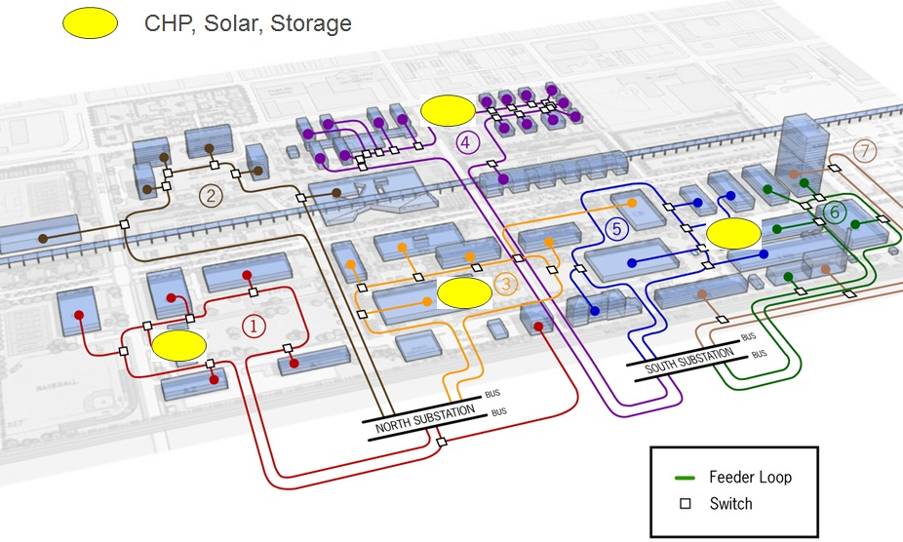
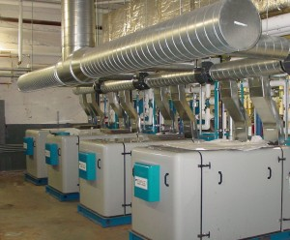
Combined Heat and Power, District Energy, Community Resilience

Slide 10
Questions
MassCEC Clean Energy Group
Twitter.com/MassCEC
Facebook.com/MassCleanEnergyCenter
Flickr.com/photos/mass_cec/

