Slide 1
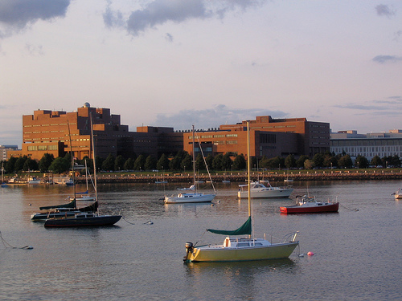
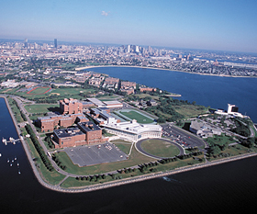
Balancing on Three Legs municipality – community - developer Monica R. Lamboy Senior Associate Edward J. Collins Jr. Center for Public Management John W. McCormack Graduate School of Policy and Global Studies University of Massachusetts Boston

Slide 2
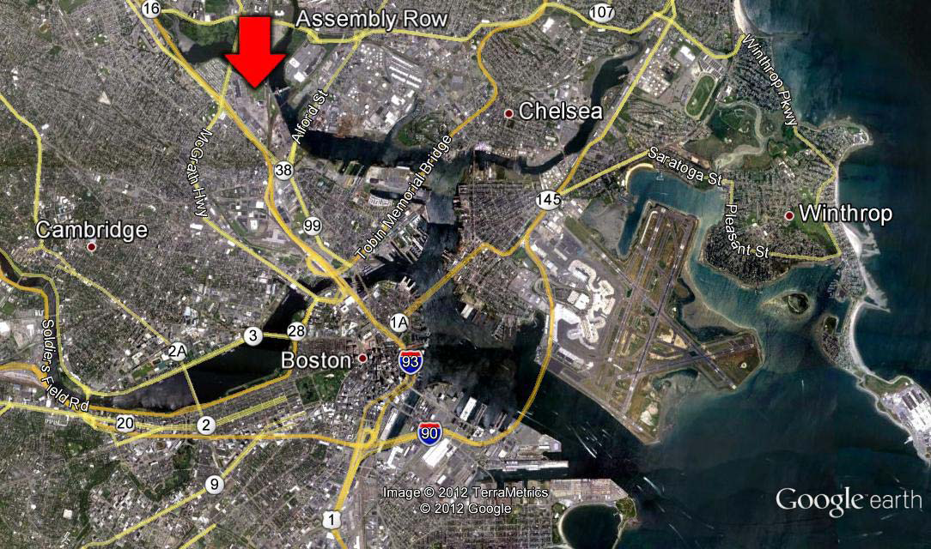
Assembly Square / Assembly Row
Notes:
Regional Perspective

Slide 3
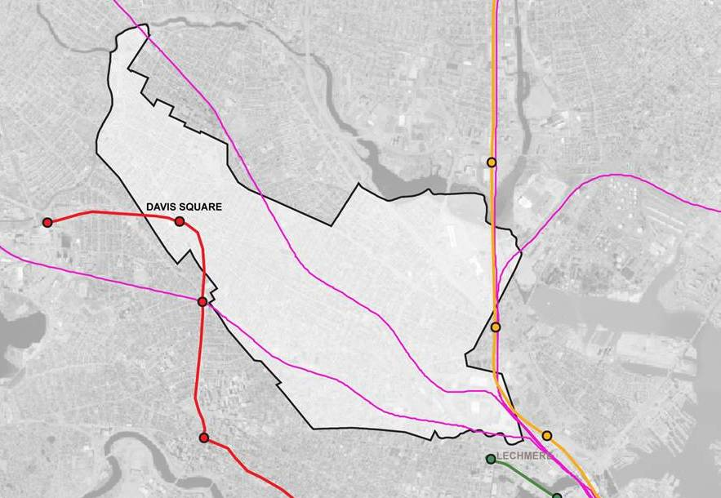
Assembly Square / Assembly Row
Notes:
City Perspective

Slide 4
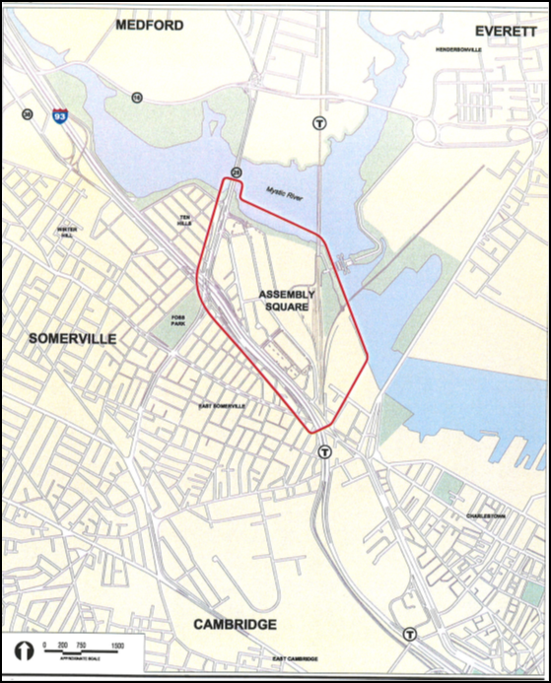
Assembly Square / Assembly Row
Notes:
District Prespective

Slide 5
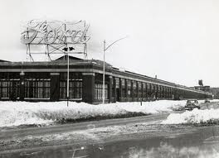
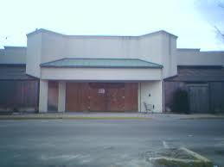
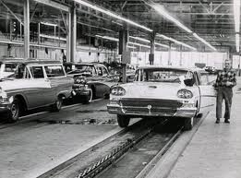
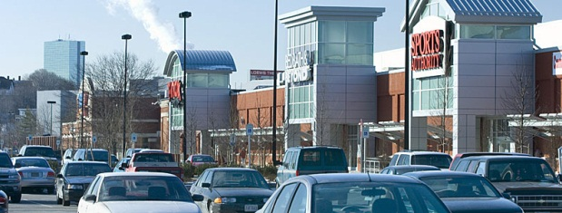
Assembly Square / Assembly Row
Notes:
Ford Assembly Plant opened in 1926; closed – 1958
Failed indoor shopping mall – 1999
ASQ District – 145 acres; Assembly Row project – 56.2 acres
In 2000, waterfront IKEA permit issued
In 2003, community members sued to get more and transit-oriented development; settlement in Jan 2007

Slide 6
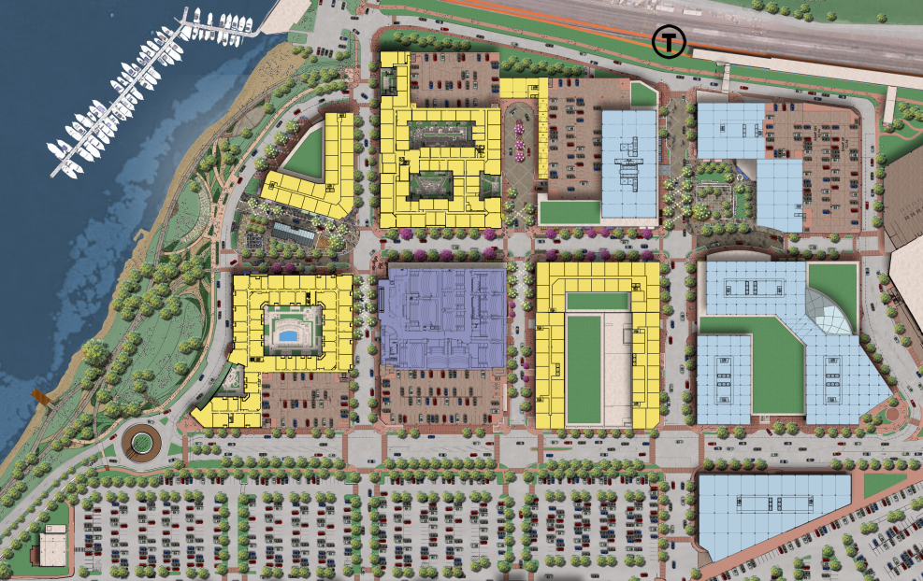
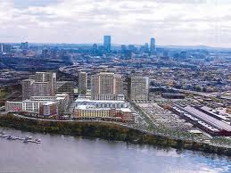
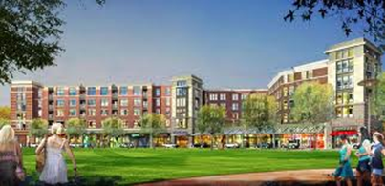
Assembly Row
Notes:
Master planned for:
1.75 million square feet of new office space;
852,000 square feet of retail (including restaurants, a cinema, and a 340,000 square foot IKEA home furnishings store);
up to 200-room hotel; and,
2,100 new residential units.

Slide 7
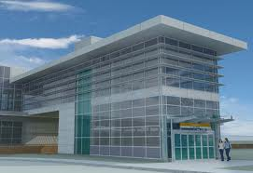
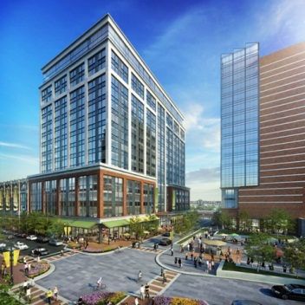
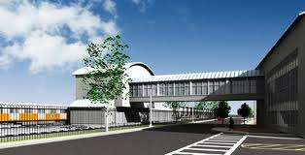
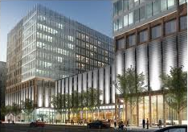
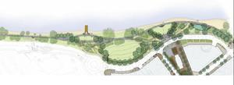
Assembly Row
Notes:
Estimated $1.36b investment - infrastructure, open space, public amenities; $50m new MBTA Orange Line Station.
Forecasted $24m in annual municipal tax revenue and $16.7m in annual state tax revenue (gross).
Estimated 9,700 permanent jobs, 10,300 construction jobs, retain 590 existing jobs.

Slide 8
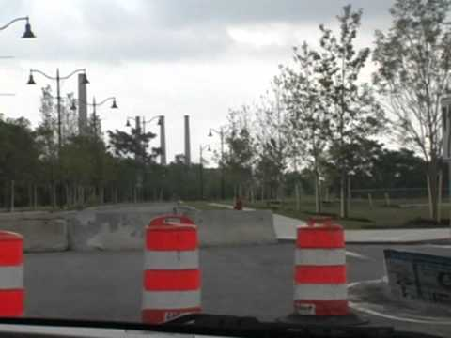
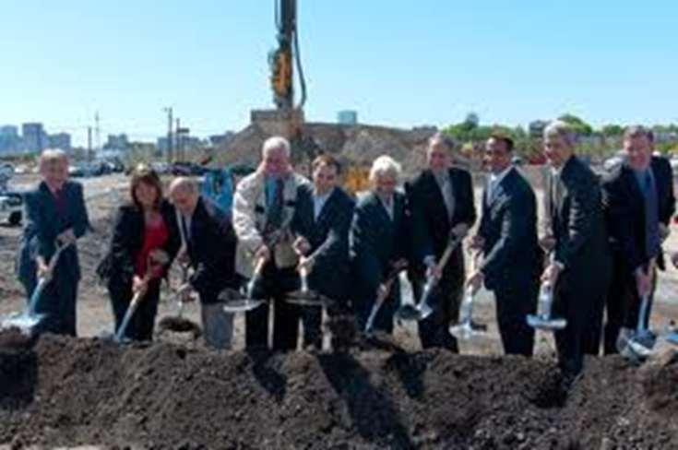
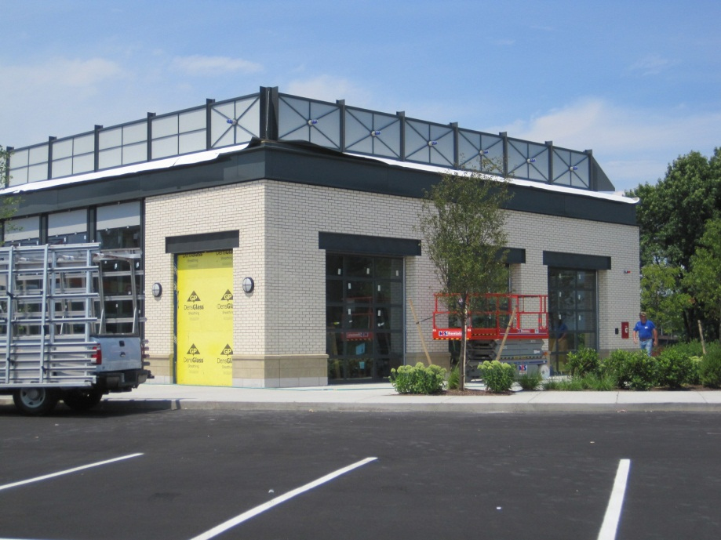
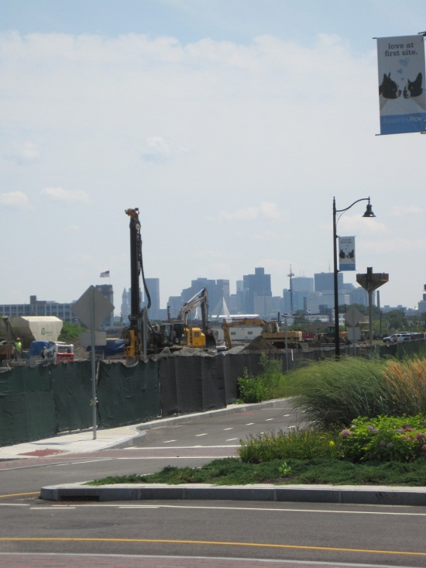
Assembly Row
Notes:
Construction is underway.

Slide 9
KEYS TO SUCCESS
ESTABLISH A COMMUNITY VISION
PROVIDE SUPPORT, BUT MAINTAIN OBJECTIVITY
KNOW THERE WILL BE BUMPS IN THE ROAD
RECOGNIZE THAT CHANGE IS DIFFICULT

Slide 10
ESTABLISH A COMMUNITY VISION

Slide 11
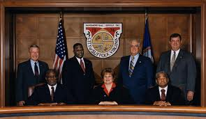
Cultivate leadership at all levels
Elected officials
Public agencies (esp. transit/transportation)
Developers/Private Corporations
Community Members
Residents
Local business leaders

Slide 12
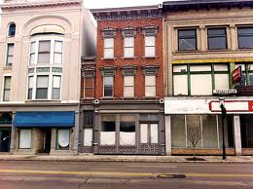
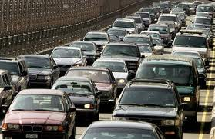
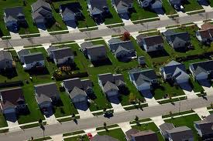
Acknowledge existing conditions

Slide 13
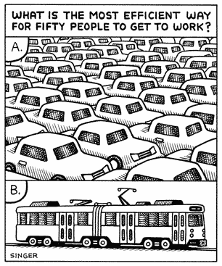
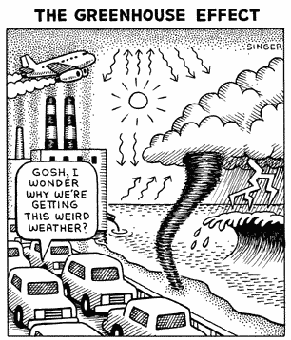
Acknowledge existing conditions
TRANSPORTATION
Public health impacts
Land use impacts
Severed neighborhoods
NEEDED SERVICES V REVENUES
Imbalance b/t commercial & residential tax burden
Need for quality schools, senior centers
INFRASTRUCTURE
Lack of public sewer/water

Slide 14
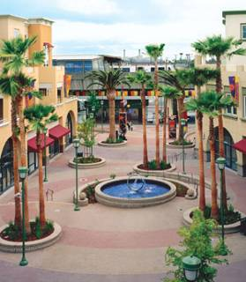
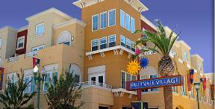
Highlight examples of success
Fruitvale Transit Village
Oakland, CA
257,000 sf “transit village” built on former BART surface parking lots
housing
office space and services
neighborhood retail
public parking
Fruitvale Public Market
An active, retail-lined connector between the BART station and the neighborhood’s primary retail artery
Fruitvale Transit Village
Mixed Use Buildings at Fruitvale
Notes:
47 units of mixed-income housing
114,000 sf of office space and services
40,000 sf of neighborhood retail
150 space garage within the buildings
Parking structure for BART
Fruitvale Public Market

Slide 15
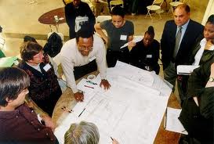
Promote a culture open to change
Community participation throughout the process
Visual modeling
Social Media
Instant Feedback Tools
World Café’s

Slide 16
PROVIDE SUPPORT,
BUT MAINTAIN OBJECTIVITY

Slide 17
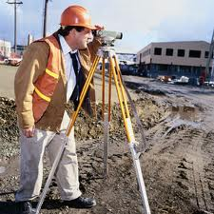
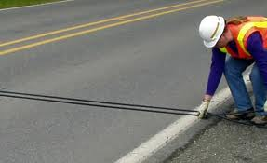
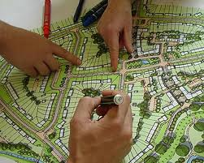
Assemble the technical team
Urban Planners
Transportation Planners
Designers
Surveyors
Environmental Consultant
LAWYERS!

Slide 18
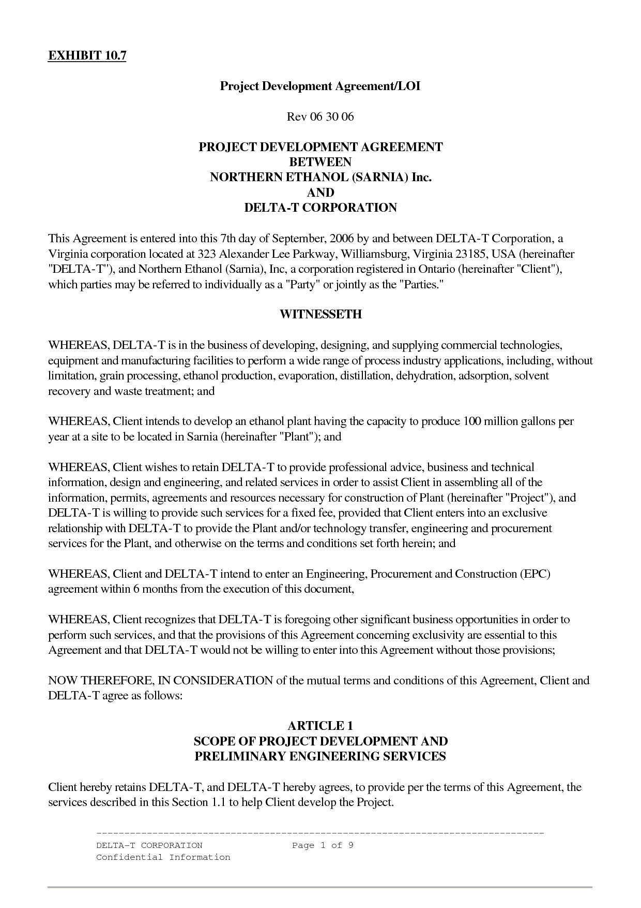
Establish public-private wkng relationship
Meet early and often
Establish key contacts and responsibilities
Document agreement
Notes:
City purchased key properties to assist with parcel assemblage, has ability to use eminent domain if needed
Community recognized need for increased development to bring new tax revenue to the City
Developer worked actively with community groups and agreed to mitigation including financial contribution to a future T-Stop

Slide 19
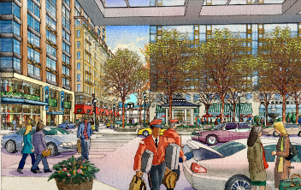
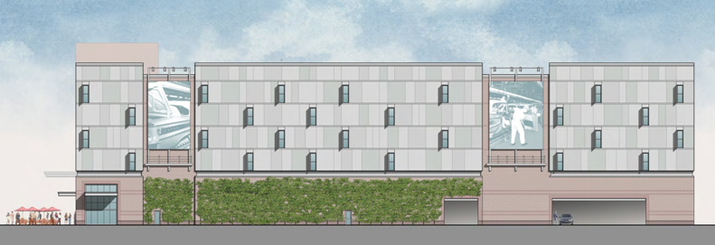
Maintain design control
Planned Unit Developments (PUD) – Master Plans
Design Review Committee and design guidelines
Special Permits
Amendments to permits
Inspections
Proposed Assembly Square
Storage facility on Middlesex Ave

Slide 20
KNOW THERE WILL BE BUMPS IN THE ROAD

Slide 21
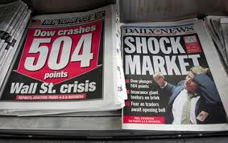
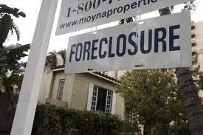
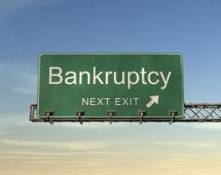
Unexpected challenges
National and Regional Economy
Financing Troubles (public and private)
Bankruptcy
Regulatory Concerns
Market Timing

Slide 22
Unexpected challenges
Ensure Development Agreement has adequate provisions
Specific deliverables, timelines, and accountability measures (ex. $ penalty, contribution to mitigation fund)
Trigger (s) for major amendment and minor amendment to agreement
Right of first refusal / eminent domain
Identify Plan B, C, D ahead of time
Ascertain line that “do not cross”

Slide 23
RECOGNIZE THAT CHANGE IS DIFFICULT

Slide 24
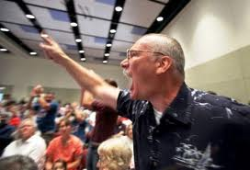
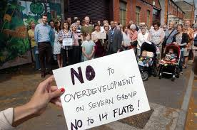
Default: Do Nothing

Slide 25
In closing
COMMUNICATE
COMMUNICATE
COMMUNICATE

